Slide 1
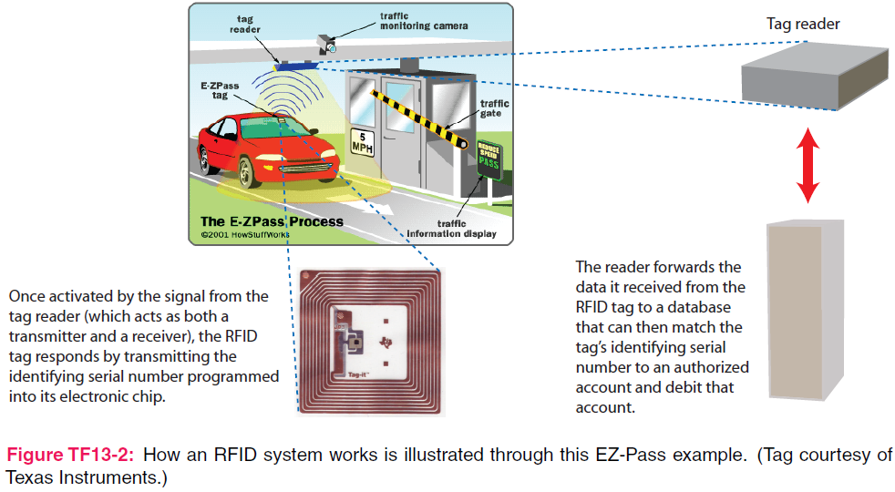
7. Plane Wave Propagation
7e Applied EM by Ulaby and Ravaioli

Slide 2
Chapter 7 Overview

Slide 3
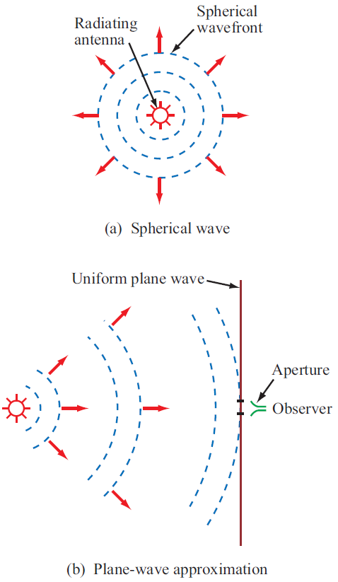
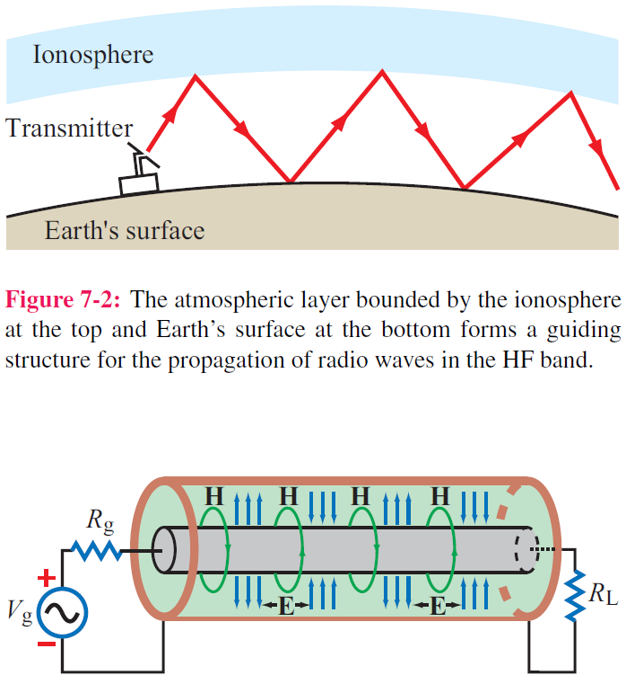
Guided EM Waves
Unbounded EM Waves

Slide 4
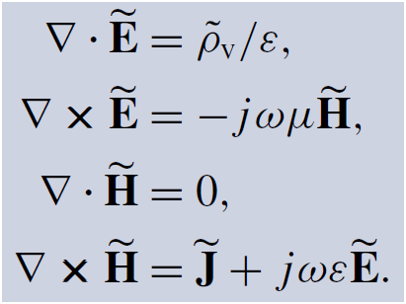
Time-Harmonic Fields
For sinusoidal time variations:
For a linear, isotropic, and homogeneous medium with ε and μ, the Maxwell’s equations in phasor form are

Slide 5
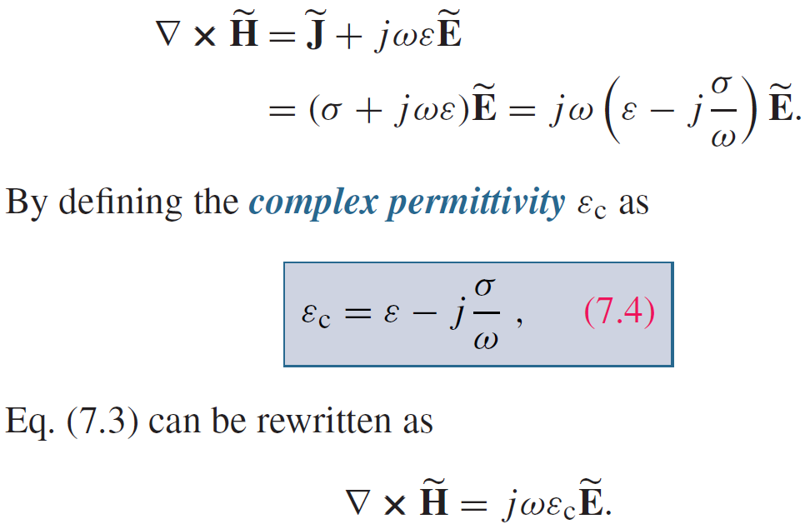
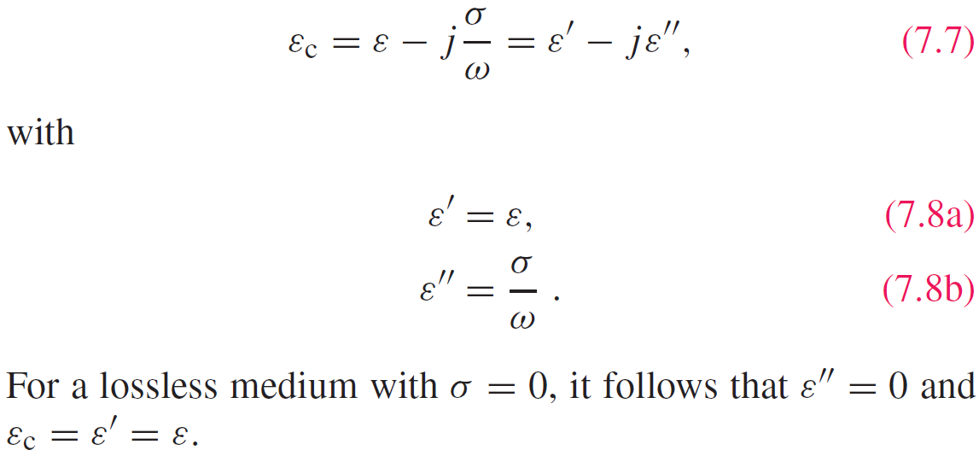
Complex Permittivity

Slide 6
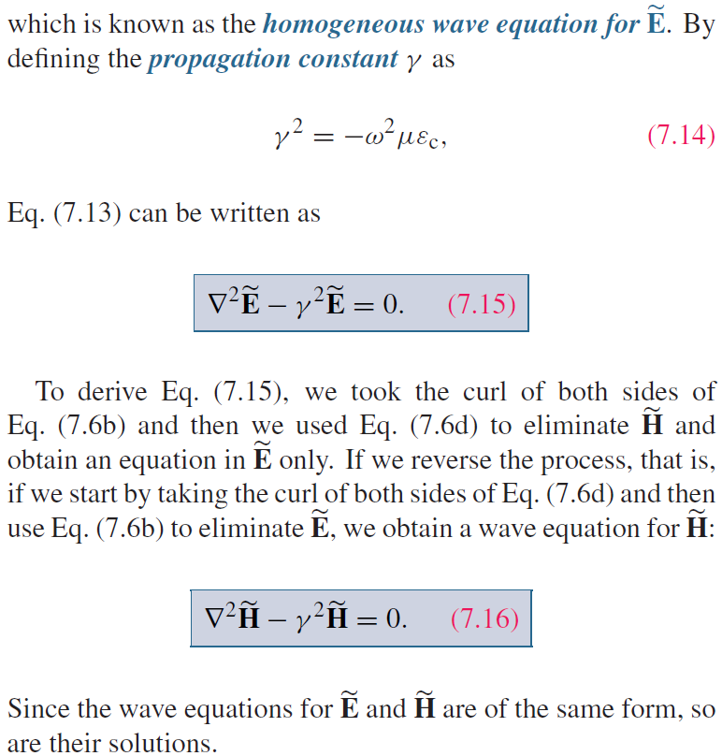
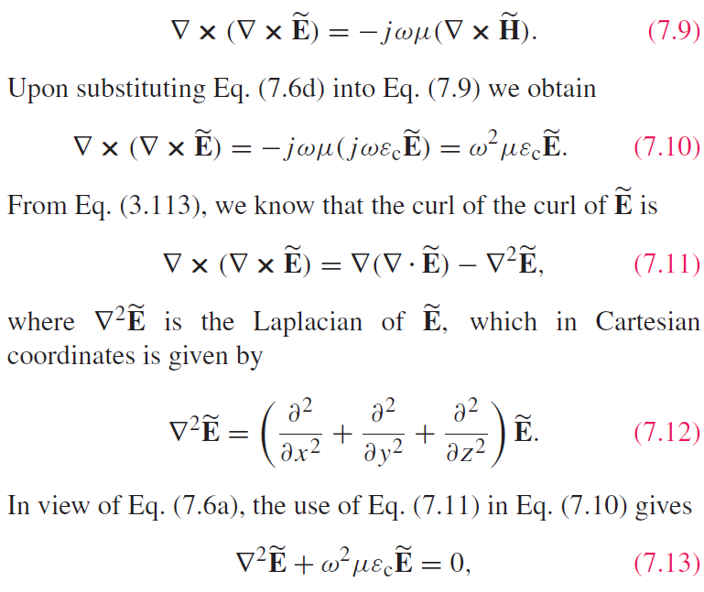
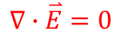
Wave Equations
Use source-free Maxwell’s equations
Helmholtz equation
$$∇∙\overset{⃑}{E}=0$$

Slide 7
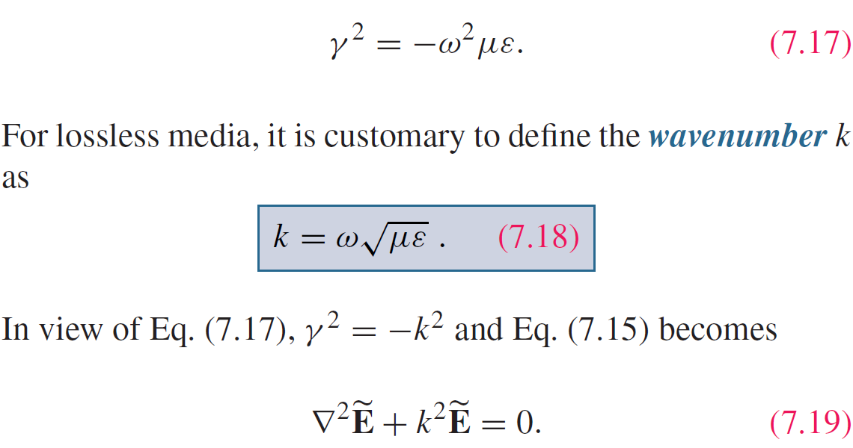
Lossless Media
If the medium is nonconducting (σ = 0), the wave does not suffer any attenuation as it travels and hence the medium is said to be lossless.

Slide 8
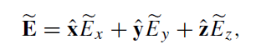
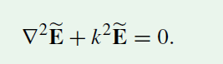
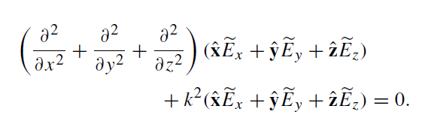
Uniform Plane Wave

Slide 9
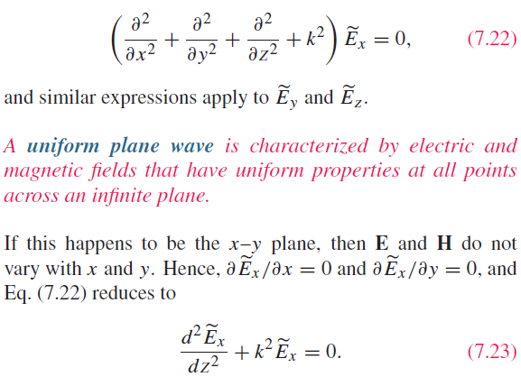
Uniform Plane Wave

Slide 10
Transverse Electromagnetic (TEM) Wave

Slide 11
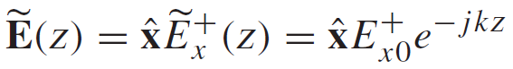
Uniform Plane Wave Solution
-z propagation
General Form of the Solution:
+z propagation
For a wave travelling along +z only:

Slide 12
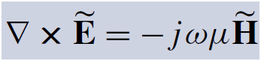
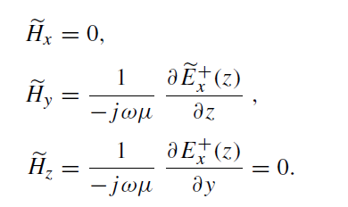
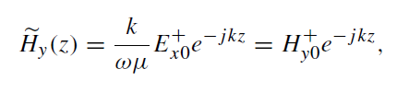
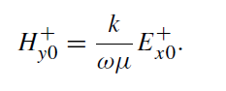
Uniform Plane Wave Solution
The corresponding M field is obtained by

Slide 13
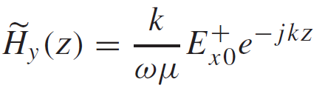
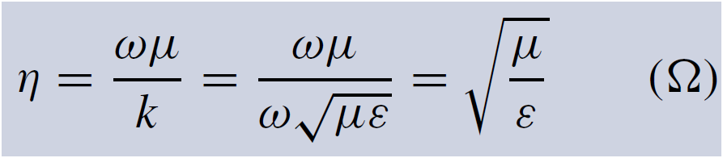
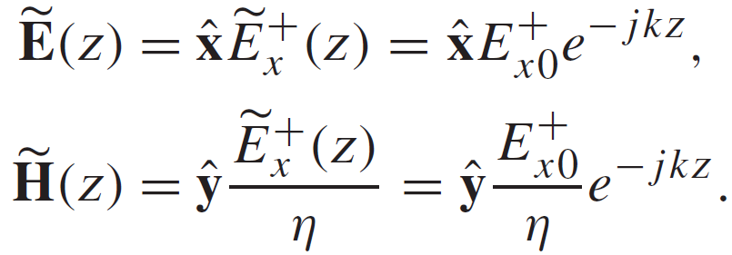
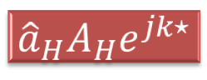
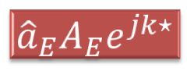
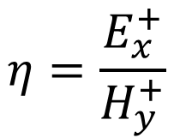
Intrinsic Impedance
$$η=\frac{E_{x}^{+}}{H_{y}^{+}}$$
Intrinsic impedance of the medium or wave impedance
Summary: This is a plane wave with
$${\hat{a}}_{E}A_{E}e^{jk⋆}$$
Exponential term for propagation
Direction
Amplitude
$${\hat{a}}_{H}A_{H}e^{jk⋆}$$

Slide 14
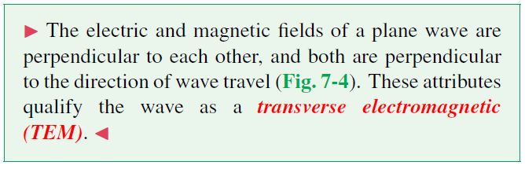
TEM wave

Slide 15
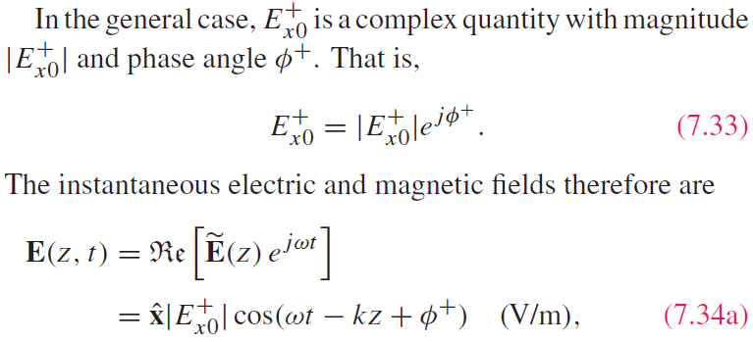
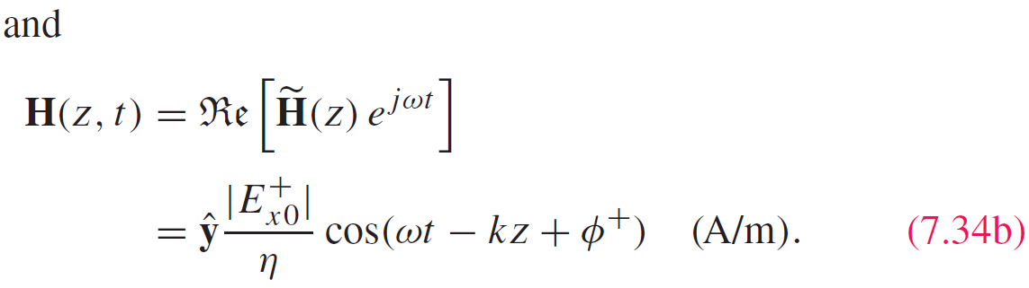
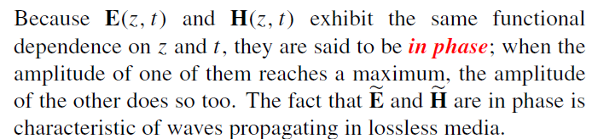
Time-Domain Solution

Slide 16
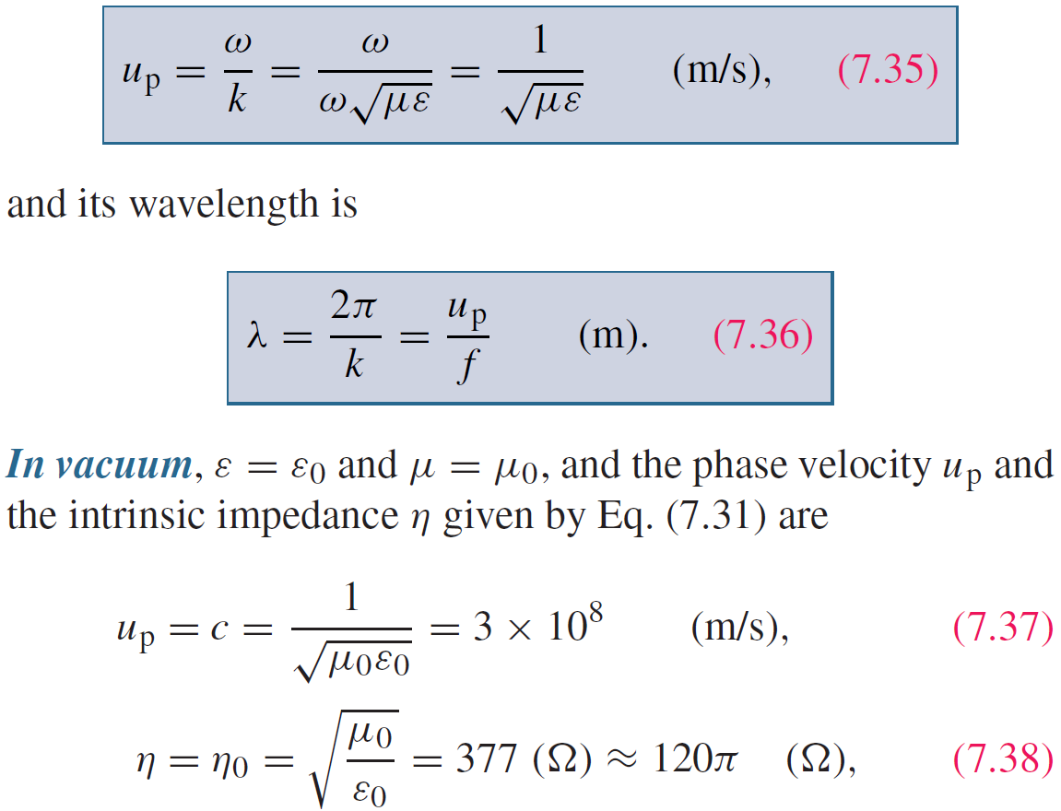
Wave’s Phase Velocity

Slide 17
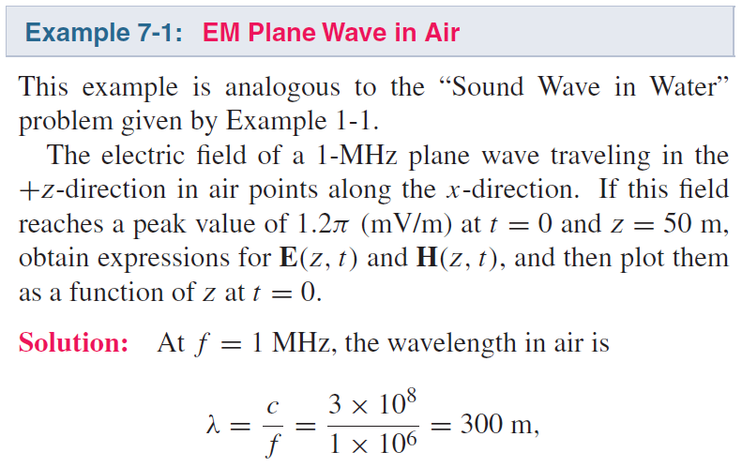
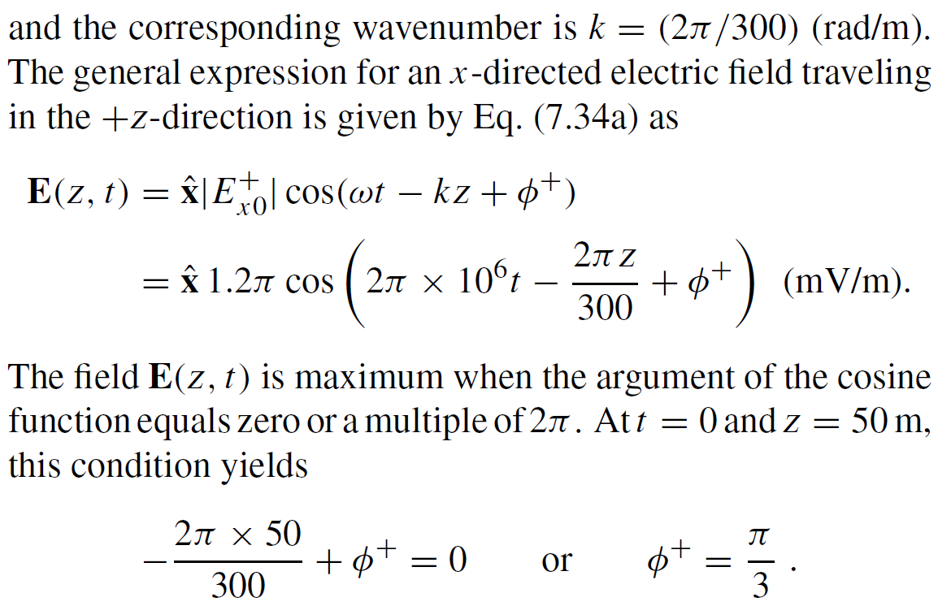
Cont.

Slide 18
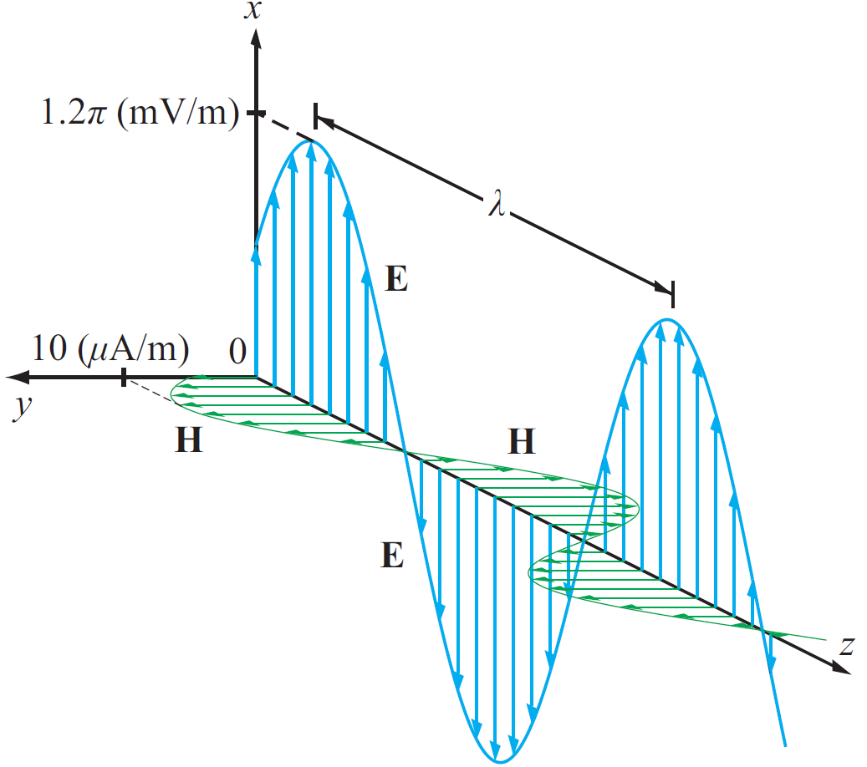
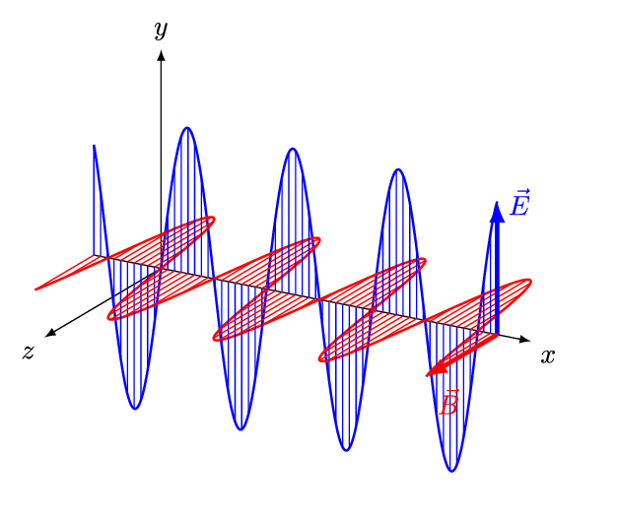
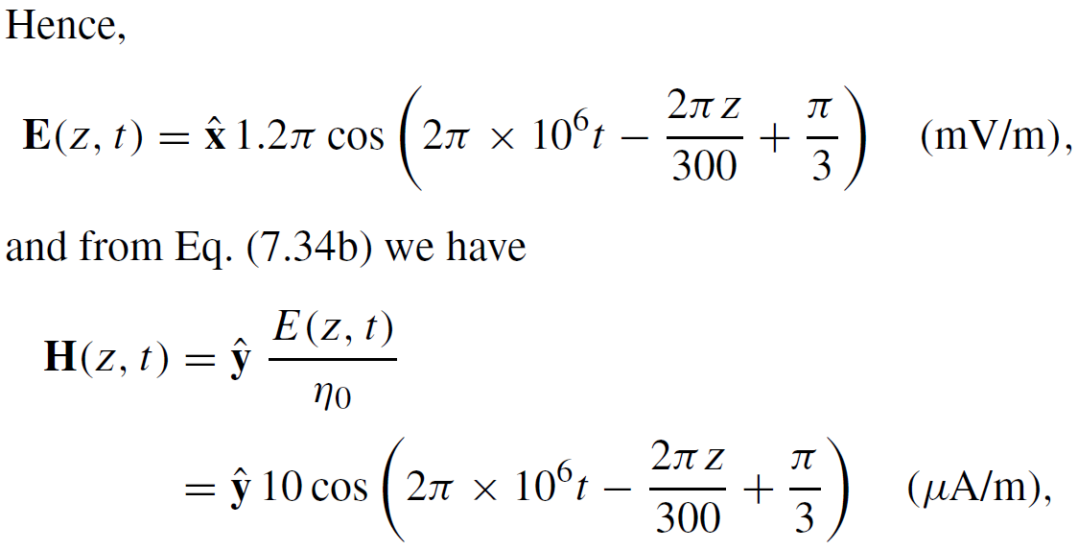
Example 7-1 cont.

Slide 19
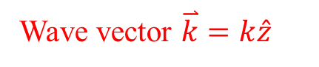
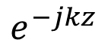
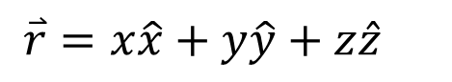
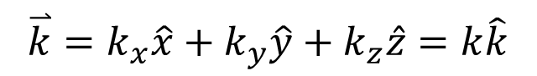
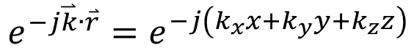
General Plane Wave
+z propagation
$$e^{−jkz}$$
Wave vector $\overset{⃑}{k}=k\hat{z}$
General-direction propagation
$$e^{−j\overset{⃑}{k}∙\overset{⃑}{r}}=e^{−j\left(k_{x}x+k_{y}y+k_{z}z\right)}$$
$$\overset{⃑}{k}=k_{x}\hat{x}+k_{y}\hat{y}+k_{z}\hat{z}=k\hat{k}$$
$$\overset{⃑}{r}=x\hat{x}+y\hat{y}+z\hat{z}$$
General plane wave
$$\overset{⃑}{E}={\overset{⃑}{E}}_{0}e^{−j\overset{⃑}{k}∙\overset{⃑}{r}}=\left(E0x\hat{x}+E0y\hat{y}+E0z\hat{z}\right)e^{−j\overset{⃑}{k}∙\overset{⃑}{r}}$$

Slide 20
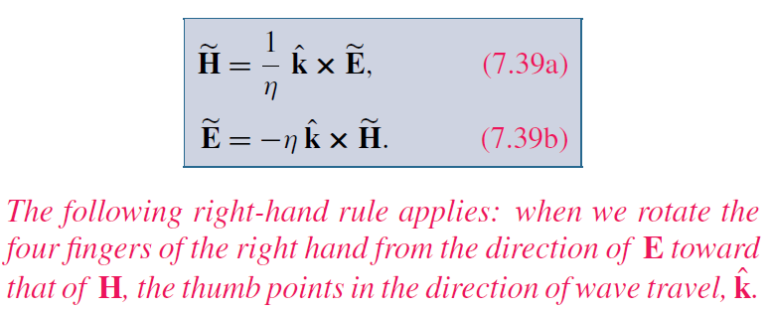
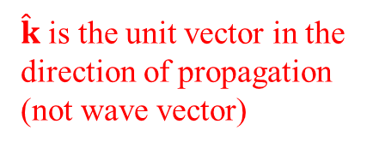
Cont.
For Any TEM Wave
$\hat{k}$ is the unit vector in the direction of propagation (not wave vector)

Slide 21
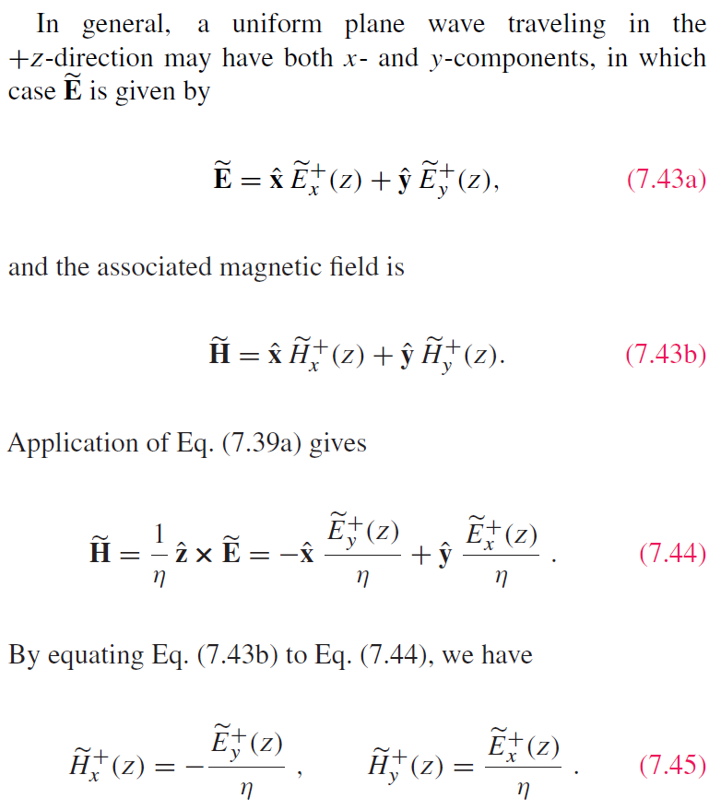
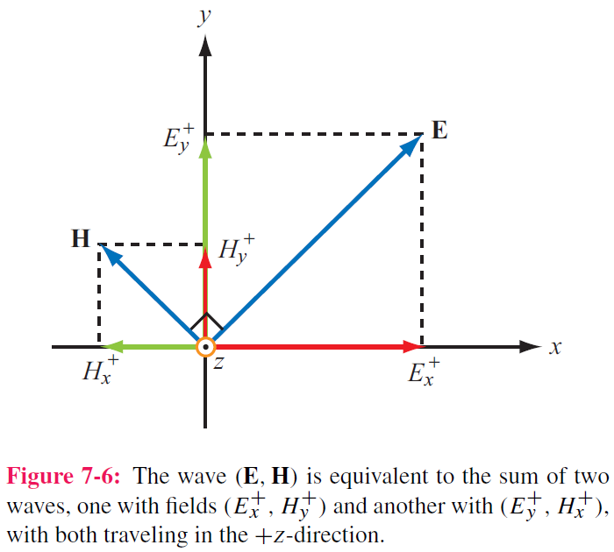
Wave decomposition

Slide 22
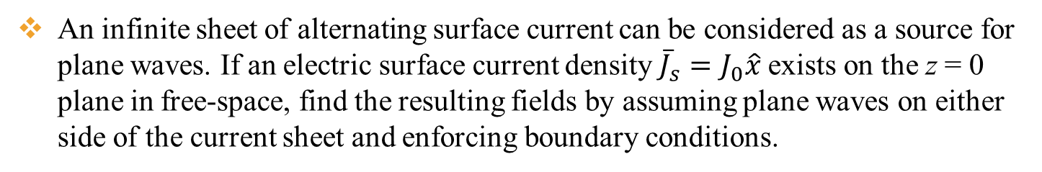
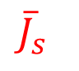
Example
An infinite sheet of alternating surface current can be considered as a source for plane waves. If an electric surface current density ${\overline{J}}_{s}=J_{0}\hat{x}$ exists on the z = 0 plane in free-space, find the resulting fields by assuming plane waves on either side of the current sheet and enforcing boundary conditions.
x
E must be in –x direction
$${\overline{J}}_{s}$$
H must be in –y direction for z propagation, and +y direction for –z propagation
Then the fields can be written in the following form with A and B are arbitrary numbers representing field amplitudes in the z < 0 and z > 0 region
z
y

Slide 23
Cont.
The boundary conditions at z = 0 are
So, we can get

Slide 24
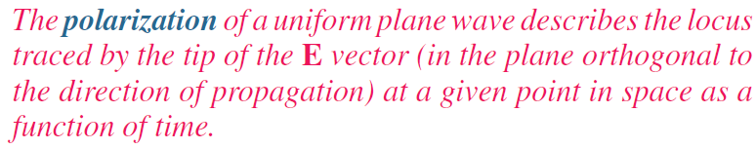
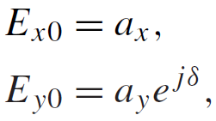
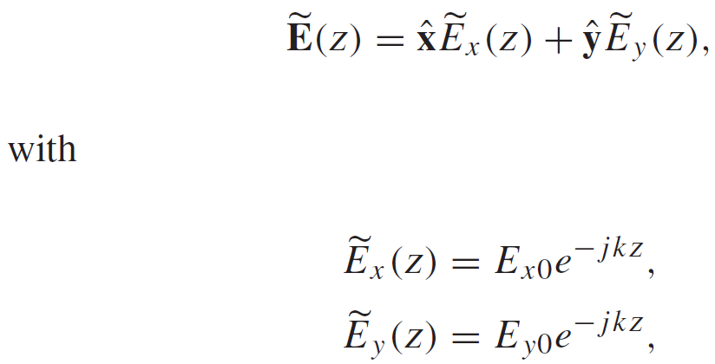
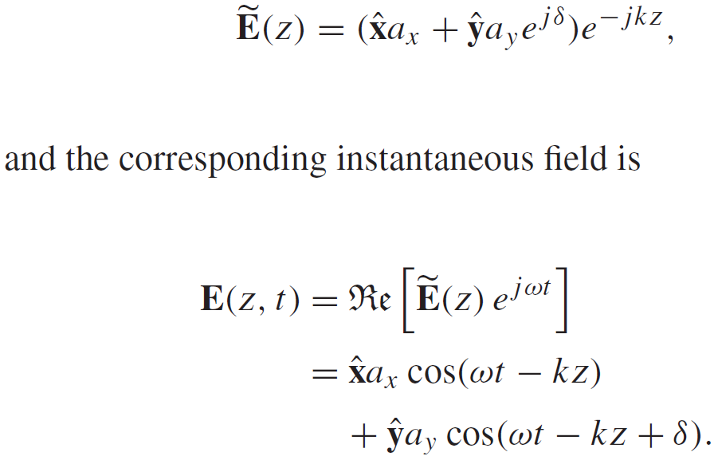

Wave Polarization
Phase difference
If:
Plane wave propagating along +z :
then
$$a_{x}≥0 a_{y}≥0$$
Generally complex numbers

Slide 25


Polarization State
Polarization state describes the trace of E as a function of time
at a fixed z
Magnitude （not amplitude） of E
Inclination Angle

Slide 26




Linear Polarization:
or
E traces a line( in blue) as the wave traverses a fixed plane
Special cases

Slide 27




Circular Polarization
Polarization Handedness
Left-hand
Right-hand

Slide 28


LH Circular Polarization:
y component is 90° ahead of x component
phase of x component needs to take T/4 to become the current phase of y component
Constant magnitude

Slide 29

RH Circular Polarization:
x component is 90° ahead of y component

Slide 30



Cont.

Slide 31
Example 7-2 cont.
Wave with electric field magnitude
of 3 (mV/m) traveling in the +y-direction
Cont.

Slide 32
Example 7-2 cont.

Slide 33




Elliptical Polarization: General Case
Linear and circular polarizations are special cases of elliptical polarization

Slide 34

Cont.

Slide 35


Example 7-3 cont.

Slide 36


Lossy Media
Lossless
Definition
Cont.

Slide 37

Lossy Media
Both are positive
Check when ε” = 0

Slide 38

Attenuation
E and H fields:
Direction
Amplitude
Attenuation
Propagation
+z propagation
Cont.

Slide 39


Attenuation
Magnitude of E
Skin depth

Slide 40

Low and High Frequency Approximations

Slide 41

Example 7-4: Plane Wave in Seawater
Cont.

Slide 42

Example 7-4: Plane Wave in Seawater
Cont.

Slide 43
Example 7-4: Plane Wave in Seawater
Cont.

Slide 44
Example 7-4: Plane Wave in Seawater
Cont.

Slide 45
Example 7-4: Plane Wave in Seawater

Slide 47




Power Density
Poynting vector:
Total power intercepted by A:
Time-average power density:

Slide 48



Plane Wave in Lossless Medium
For a plane wave with E H field :
Generally complex numbers
The time-average power density carried by the wave is:

Slide 49






Plane Wave in Lossy Medium
For a plane wave travelling in a lossy medium:
If $\overset{⃑}{E}×{\overset{⃑}{H}}^{∗}$ is complex, only the real part represents the real power that can flow with the wave propagation
the power density is :

Slide 50




Slide 51






Power Density of Different Polarization
$$\overset{⃑}{H}=\hat{y}\frac{E_{0}}{η_{0}}e^{−jkz}$$
Linear Polarization
$$\overset{⃑}{E}=\hat{x}E_{0}e^{−jkz}$$
$${\overset{⃑}{S}}_{av}=\frac{1}{2}Re\left[\overset{⃑}{E}×{\overset{⃑}{H}}^{∗}\right]=\hat{z}\frac{{\left|E_{0}\right|}^{2}}{2η_{0}}$$
Circular Polarization
$$\overset{⃑}{H}=\frac{E_{0}}{η_{0}}\left(\hat{y}−j\hat{x}\right)e^{−jkz}$$
$$\overset{⃑}{E}=E_{0}\left(\hat{x}+j\hat{y}\right)e^{−jkz}$$
$${\overset{⃑}{S}}_{av}=\frac{1}{2}Re\left[\overset{⃑}{E}×{\overset{⃑}{H}}^{∗}\right]=\frac{E_{0}^{2}}{2η_{0}}Re\left[\left(\hat{x}+j\hat{y}\right)e^{−jkz}×\left(\hat{y}+j\hat{x}\right)e^{jkz}\right]$$
$$=\frac{E_{0}^{2}}{2η_{0}}Re\left[\left(\hat{x}+j\hat{y}\right)×\left(\hat{y}+j\hat{x}\right)\right]=\frac{E_{0}^{2}}{2η_{0}}Re\left[\hat{z}+\hat{z}\right]=\hat{z}\frac{{\left|E_{0}\right|}^{2}}{η_{0}}$$
Total fields

Slide 52

Summary
Homework due XXX

